Slide 1
K-Nearest Neighbor
Sadia Islam Assistant Professor
Department of Computer Science and engineering United International University

Slide 2
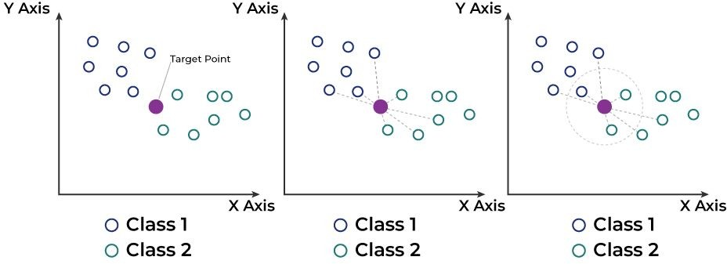
The K-Nearest Neighbors (KNN) algorithm is a simple, yet powerful, machine learning algorithm commonly used for both classification and regression tasks.
KNN
Notes:
What is KNN?
KNN is a machine learning algorithm that predicts the class or value of a point based on its neighbors. It’s simple and works well for both classification (categorizing data) and regression (predicting numbers).
How does it work?
Plot the data:
Each data point belongs to a class (e.g., Class 1 = blue circles, Class 2 = green circles).
Target point:
There’s a new point (purple in the diagram) that you want to classify or predict.
Find neighbors:
Measure the distance (like straight lines) from the target point to all other points in the dataset.
Pick the closest K points (e.g., K = 3 means the 3 nearest points).
Majority vote:
For classification:
Check the classes of the K neighbors.
Assign the target point to the class that most neighbors belong to.
For regression:
Take the average value of the neighbors.
Example from the image:
Left: The target point’s closest neighbors (K = 3) are 1 blue circles (Class 1) and 2 green circle (Class 2).
Majority vote → Target point belongs to Class 2.
Middle: If K = 5, the algorithm considers 5 nearest neighbors. Now, there are 3 green (Class 2) and 2 blue (Class 1).
Majority vote → Target point belongs to Class 2.
Right: If K = 7, it includes more neighbors. Majority voting changes based on the composition of these neighbors.
Why is KNN "lazy"?
kNN classifier is that it is a lazy learner, i.e. it does not learn anything from the training data and simply uses the training data itself for classification.

Slide 3
KNN classifier
The KNN classifier works by finding the 'k' closest data points (neighbors) to the point you want to classify and then assigns it to the most common class among those neighbors.
Steps:
Choose the number of neighbors (k): This is typically a small, odd number.
Calculate the distance: Compute the distance between the new point and all other points in the dataset.
Select the neighbors: Choose the 'k' points that are closest to the new point.
Majority vote: Assign the new point to the class that is most common among the selected 'k' neighbors.

Slide 4
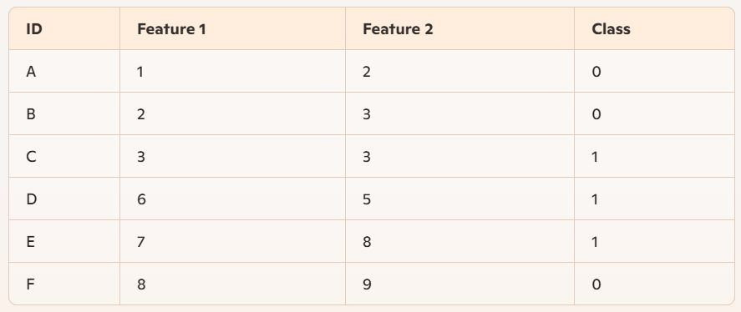
KNN classifier- example
Let's say we have a small dataset with two features and a binary class label (either 0 or 1):

Slide 5
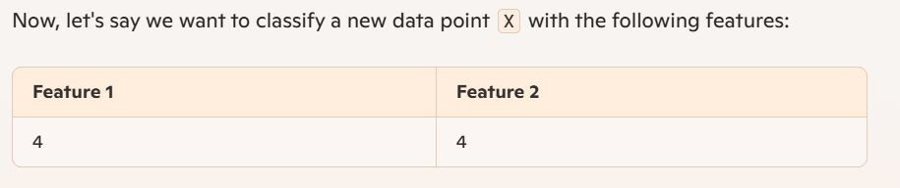
KNN classifier - example
New Data Point to Classify
●

Slide 6
KNN classifier - example
Calculate Distances
We will use Euclidean distance to calculate distance
The Euclidean distance formula is: distance = sqrt{(x_2 - x_1)^2 + (y_2 - y_1)^2}
Distance from X to A: sqrt{(4 - 1)^2 + (4 - 2)^2} = \sqrt{9 + 4} = \sqrt{13} = 3.6
In the same way:
Distance from X to B = 2.2
Distance from X to C = 1.4
Distance from X to D = 2.2
Distance from X to E = 5.0
Distance from X to F = 6.4

Slide 7
KNN classifier - example
Choose k and Find Nearest Neighbors
Assume k=3. We choose the 3 nearest neighbors to X:
  Neighbors: C (1.4), B (2.2), D (2.2)

Slide 8
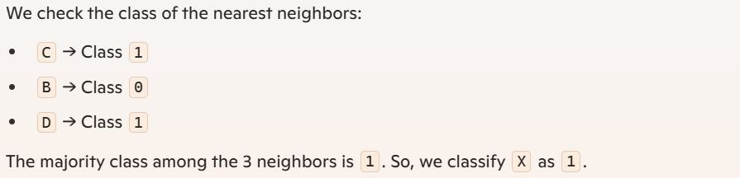
KNN classifier - example
Classify Based on Majority Vote
●

Slide 9
KNN Regression
KNN regression predicts the value of a new data point based on the average (or sometimes a weighted average) of the 'k' nearest neighbors.
Steps:
Choose the number of neighbors (k): Select a small, odd number.
Calculate the distance: Measure the distance between the new point and all other points in the dataset.
Select the neighbors: Identify the 'k' closest points to the new point.
Average the values: Compute the average of the target values of the 'k' neighbors.

Slide 10
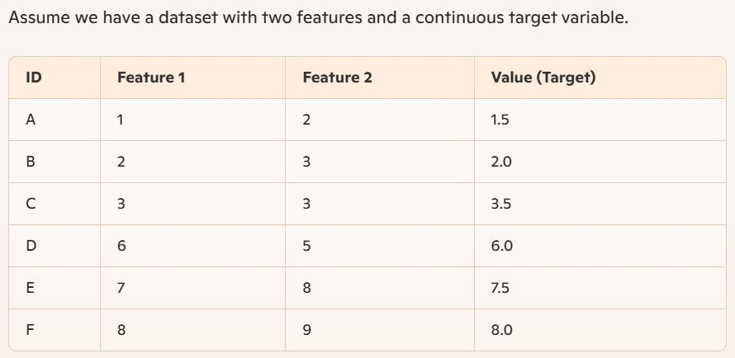
KNN Regression - example
●

Slide 11
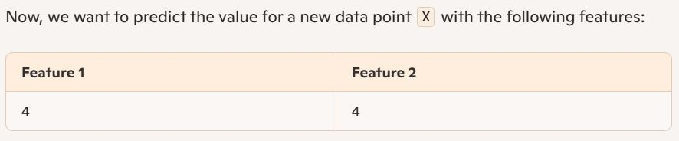
KNN Regression - example
New Data Point to Predict

Slide 12
KNN Regression - example
Calculate Distances
We'll use Euclidean distance to find the distances between X and all the points in the dataset.
Distance from X to A = 3.6
Distance from X to B = 2.2
Distance from X to C = 1.4
Distance from X to D = 2.2
Distance from X to E = 5.0
Distance from X to F = 6.4

Slide 13
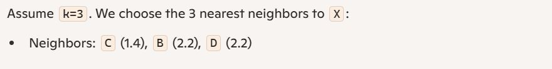
KNN Regression - example
Choose k and Find Nearest Neighbors

Slide 14
KNN Regression - example
Predict the Value
To predict the value for X, we take the average of the target values of the nearest neighbors:
Values of nearest neighbors: 3.5 (C), 2.0 (B), 6.0 (D)
Predicted value: (3.5 + 2.0 + 6.0) / 3 = 11.5 / 3 = 3.83
So, the predicted value for X using KNN regression is approximately 3.83.

Slide 15
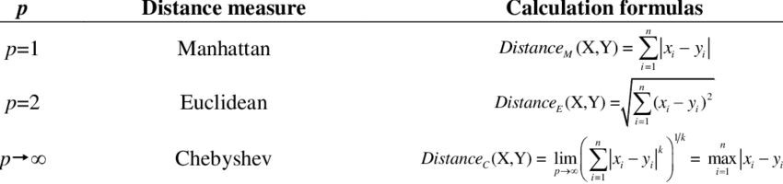
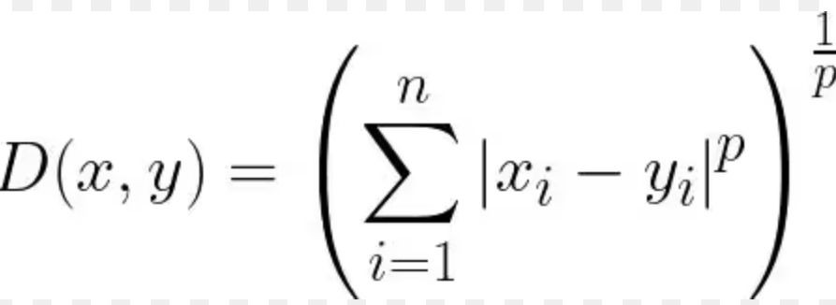
Measuring Distance
Minkowski distance,

Slide 16
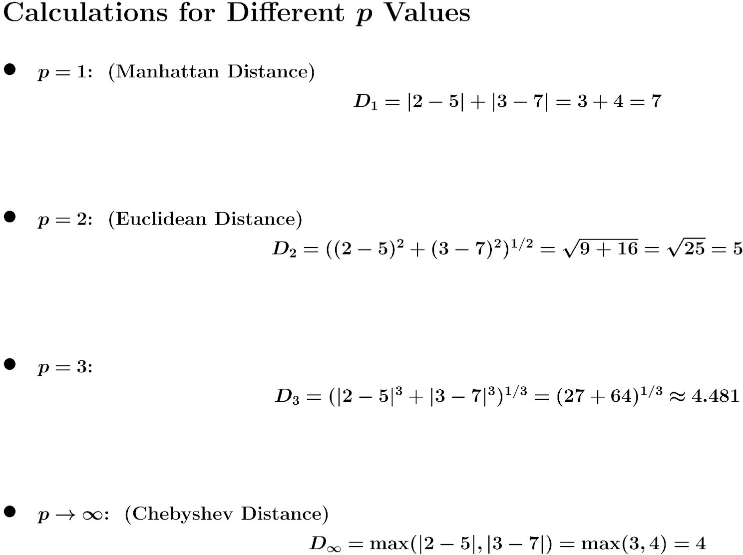
Minkowski Distance
Considering two points in a 2D space:
Point A: (2, 3)
Point B: (5, 7)

Slide 17
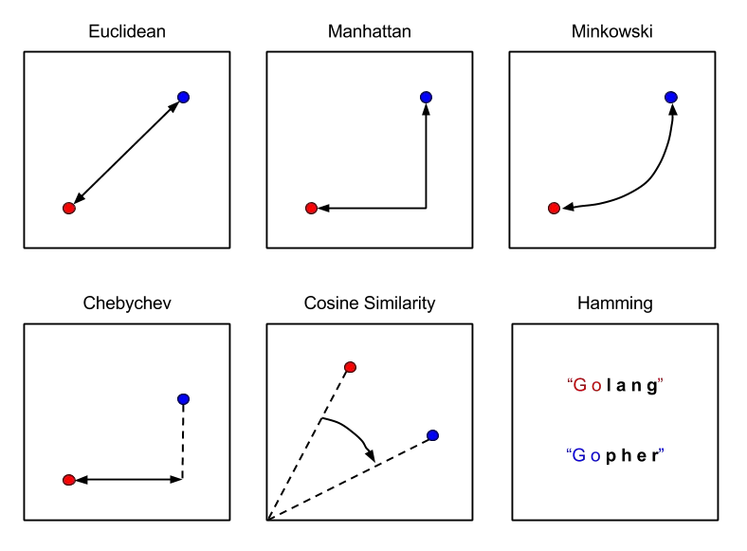
Measuring Distance

Slide 18
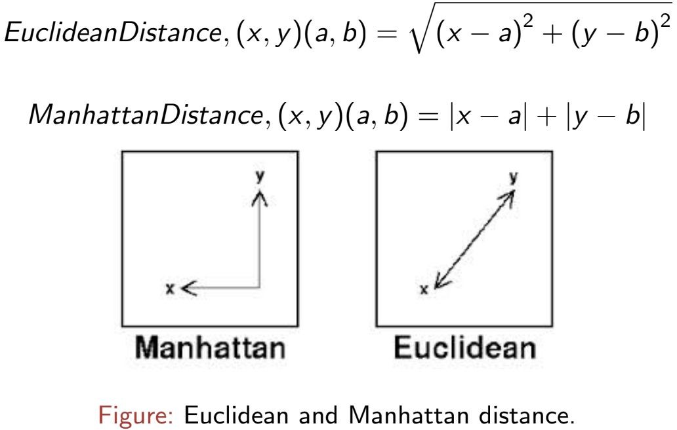
Measuring Distance for two data points

Slide 19
Advantages and Disadvantages of using KNN
Advantages:
The algorithm is simple.
Requires no assumptions about the data.
Disadvantages:
The main disadvantage of the kNN classifier is that it is a lazy learner, i.e. it does not learn anything from the training data and simply uses the training data itself for classification.
A serious drawback associated with (k)NN technique is the complexity, (O(kN))2, in search of the nearest neighbour(s) among the N available training samples. Although, due to its asymptotic error performance, the kNN rule achieves good results when the data set is large, the performance of the classifier may degrade dramatically when the value of N training instances is relatively small.
Notes:
kNN has a drawback of high complexity, (O(kN))2, as it searches through all N training points to find the k nearest neighbors. It performs well with large datasets due to its asymptotic error reduction but struggles with small datasets where fewer examples can lead to poor performance.

Slide 20
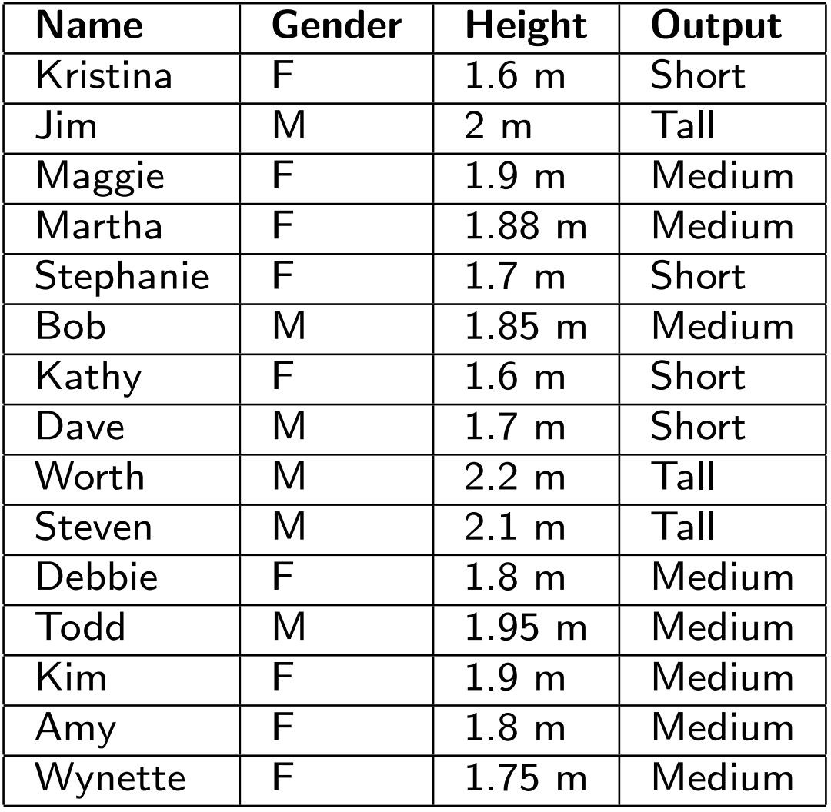
Example
Classify the instance (Pat, F, 1.6) using KNN Classifier.
Considering k = 5
Notes:
Step 1: Identify the features and distance metric
Features used for comparison:
Gender (F/M): Categorical feature.
Height: Numerical feature.
Since "Gender" is categorical and identical (Pat is F), we will not calculate its distance as it doesn’t differ in this case.
Use the Manhattan Distance formula for numerical features:
d=∣Height of Pat−Height of another person∣
For each record, calculate the absolute difference in height.
Step 2: Calculate distances
1. Kristina
Height: 1.6 m
Distance from Pat: ∣1.6−1.6∣=0.0
Output: Short
2. Jim
Height: 2.0 m
Distance from Pat: ∣1.6−2.0∣=0.4
Output: Tall
3. Maggie
Height: 1.9 m
Distance from Pat: ∣1.6−1.9∣=0.3
Output: Medium
4. Martha
Height: 1.88 m
Distance from Pat: ∣1.6−1.88∣=0.28
Output: Medium
5. Stephanie
Height: 1.7 m
Distance from Pat: ∣1.6−1.7∣=0.1
Output: Short
6. Bob
Height: 1.85 m
Distance from Pat: ∣1.6−1.85∣=0.25
Output: Medium
7. Kathy
Height: 1.6 m
Distance from Pat: ∣1.6−1.6∣=0.0
Output: Short
8. Dave
Height: 1.7 m
Distance from Pat: ∣1.6−1.7∣=0.1
Output: Short
9. Worth
Height: 2.2 m
Distance from Pat: ∣1.6−2.2∣=0.6
Output: Tall
10. Steven
Height: 2.1 m
Distance from Pat: ∣1.6−2.1∣=0.5
Output: Tall
11. Debbie
Height: 1.8 m
Distance from Pat: ∣1.6−1.8∣=0.2
Output: Medium
12. Todd
Height: 1.95 m
Distance from Pat: ∣1.6−1.95∣=0.35
Output: Medium
13. Kim
Height: 1.9 m
Distance from Pat: ∣1.6−1.9∣=0.3
Output: Medium
14. Amy
Height: 1.8 m
Distance from Pat: ∣1.6−1.8∣=0.2
Output: Medium
15. Wynette
Height: 1.75 m
Distance from Pat: ∣1.6−1.75∣=0.15
Output: Medium
Step 3: Select the nearest k=5 neighbors
1. Kristina
Gender: Female
Height: 1.6 m
Distance from Pat: 0.0
Output: Short
2. Kathy
Gender: Female
Height: 1.6 m
Distance from Pat: 0.0
Output: Short
3. Stephanie
Gender: Female
Height: 1.7 m
Distance from Pat: 0.1
Output: Short
4. Dave
Gender: Male
Height: 1.7 m
Distance from Pat: 0.1
Output: Short
5. Wynette
Gender: Female
Height: 1.75 m
Distance from Pat: 0.15
Output: Medium
Step 4: Classify based on the majority class
From the 5 nearest neighbors:
Short: 4 neighbors (Kristina, Kathy, Stephanie, Dave)
Medium: 1 neighbor (Wynette)
The majority class is Short.
Final Classification
The instance (Pat, F, 1.6) is classified as Short.

